Slide 1

Testing Challenge #1
Web Testing
$: whoami
Ihor Sakaylyuk PI-13-2

Slide 2
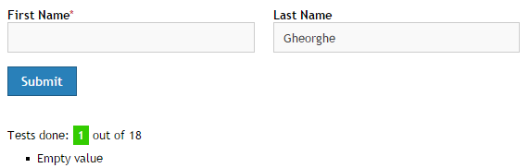
1. Empty Value
User may forget to enter text to one of the fields, so it's necessary to test filed on empty value.

Slide 3
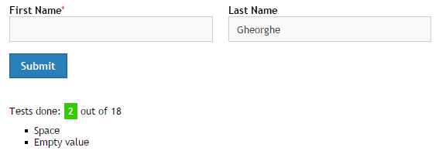
2. Space character
User may try to put space character to input box, and it should not crash the application.

Slide 4
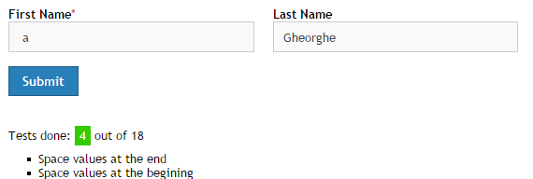
3-4. Space at the beginning and at the end
Spaces should not influence on the result.

Slide 5
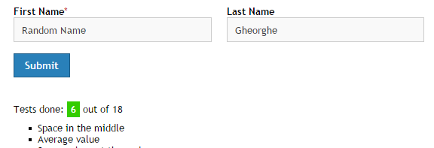
5-6. Space at middle. Average value
Space at the middle should be ignored. When user enter average value everything should be ok.

Slide 6
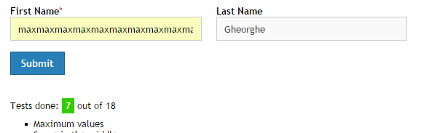
7. Maximum value
Should work find with max value(30 characters).

Slide 7
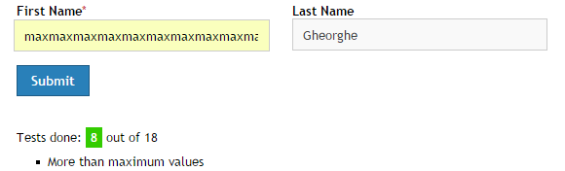
8. More than maximum value
Web site should work correctly even when more than maximum value had been entered.

Slide 8
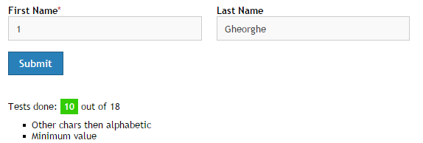
9-10. Minimum value. Non-alphabetic symbol
Should work as expected with non-alphabetic symbol and with minimum value.

Slide 9
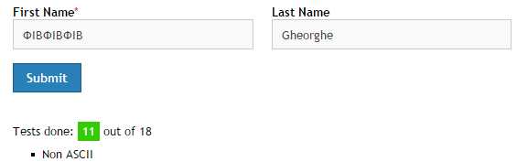
11. Non ASCII character
Should accept non ASCII character.

Slide 10
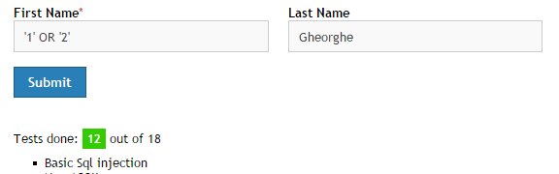
12. SQL-injection
Should not create side effects when sql-injection has been passed.

Slide 11
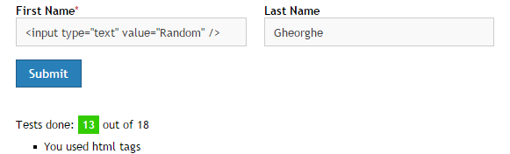
13. HTML tags
Should escape HTML-character.

Slide 12
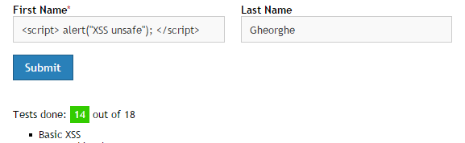
14. XSS-attack
XSS should be escaped and shouldn't occur any side effects.

Slide 13
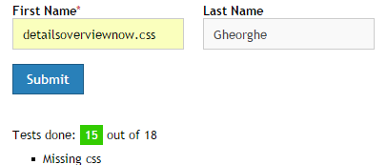
15. Missing CSS
All additional resources should be correctly downloaded.
This shouldn't have happened.

Slide 14
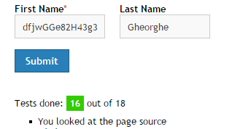
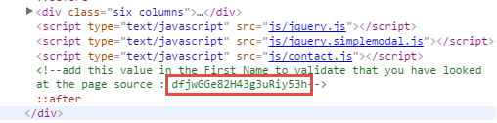
16. Page source
In HTML should not be any comments??? Really? I don't know why anyone need to test something like this.

Slide 15
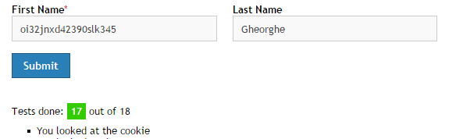
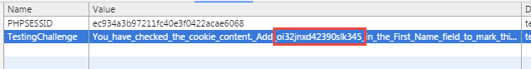
17. Useless Cookies
Server should not produce response with useless cookies??? The farther I go, the less I understand.

Slide 16
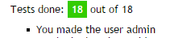
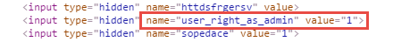
18. Questionable security approach.
Pentagon-like security)))!!! Seriously?! It's completely senseless.

Slide 17
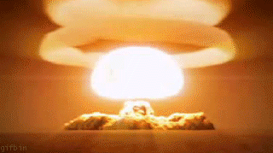

Slide 18
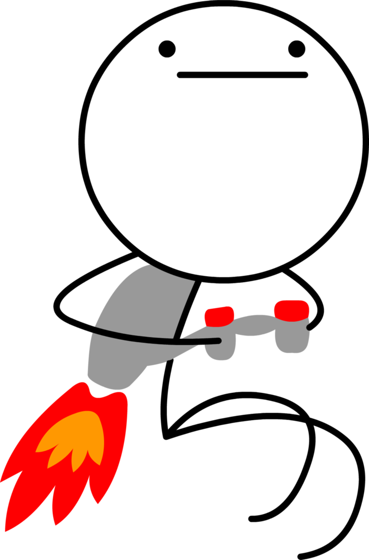
Ok. I'm done with it

